Slide 1
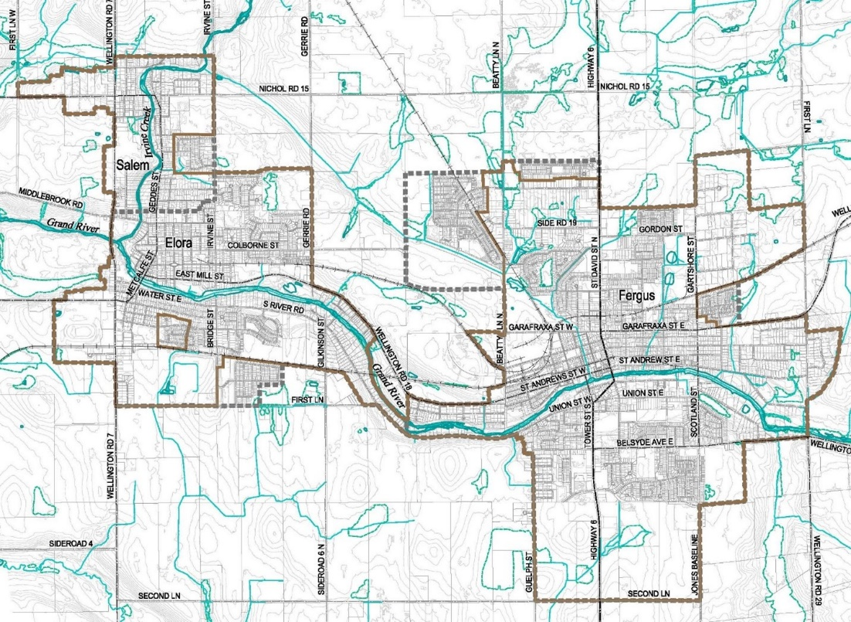
Stormwater Management Master Plan for Township of Centre Wellington (Fergus and Elora) - Public Information Centre #1
The Township is undertaking its first Stormwater Management Master Plan. We invite you to inform the development of this Master Plan by providing your feedback.
Stormwater refers to rain and snowmelt that either seeps into the ground or runs off the land into storm sewers, streams, and lakes.
Study Area
The Stormwater Management Plan will:
Assess the effectiveness of existing stormwater drainage systems
Identify and predict the potential impacts of existing and future development on stormwater quality and quantity
Identify and evaluate alternative solutions for these areas to improve levels of service.
Innovative approaches such as Low Impact Development (LID) and green infrastructure will also be explored within the Township right-of-way with emphasis on water quality.

Slide 2
Existing Stormwater System
Consultation is a key aspect of this study. Consultation is planned with the public, Indigenous Nations, interested stakeholders, and Government Agencies.
Do you know any known areas of drainage / flooding concern in your neighbourhood?
We encourage you to share that knowledge with us by filling a comment form.
15 Stormwater Management Facilities
4 Oil and Grit Separators
106 km long network of Storm Sewers
534 Maintenance Holes
3,351 Catchbasins and Maintenance Holes

Slide 3
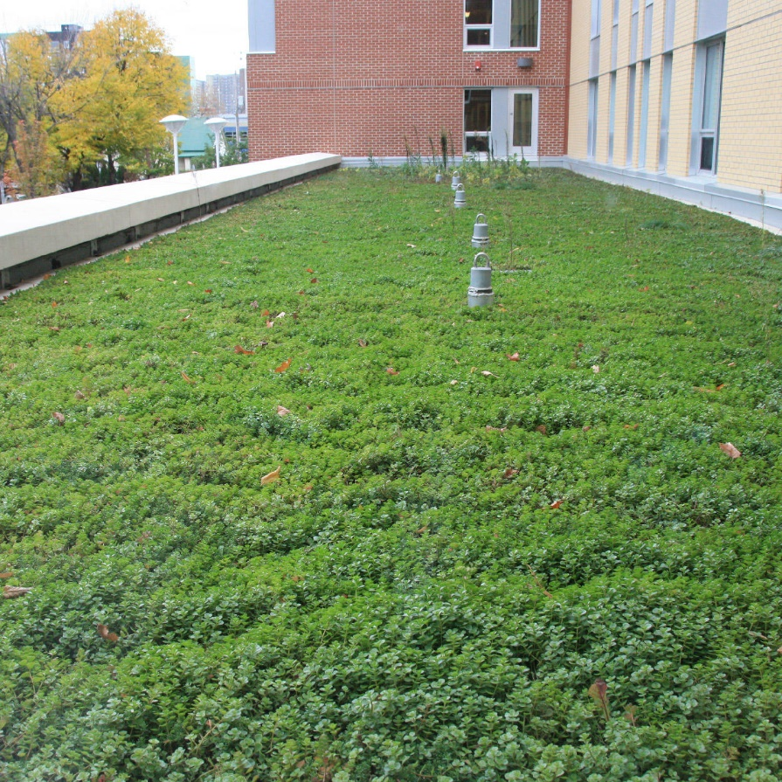
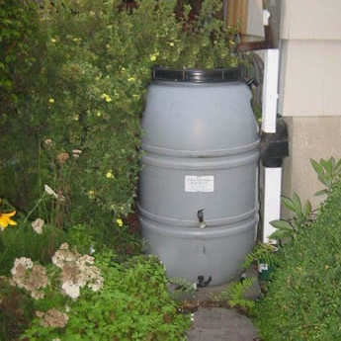
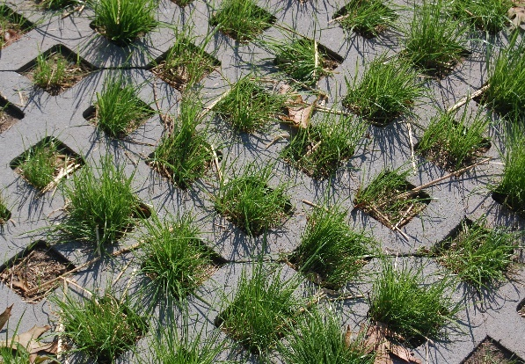
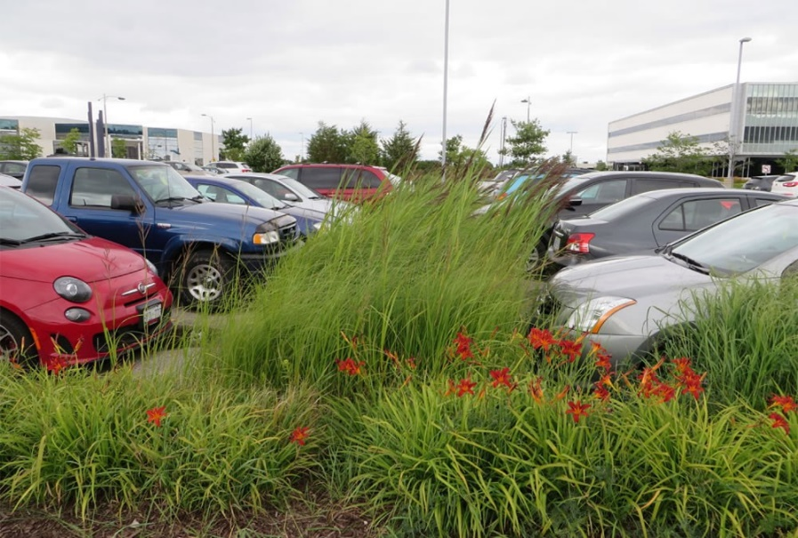
Stormwater Management Practices to Consider
Storm Sewer Upgrades - improve conveyance capacity in areas with identified deficiencies
Source control (LID) measures –green roofs, permeable pavement, cisterns and rain barrels
Conveyance control (LID) measures – bioswales, enhanced grassed swales, infiltration trenches
End-of-pipe measures – wet ponds, dry ponds, wetlands, underground storage tanks
Downspout and foundation drain disconnection – reduce connections to storm sewers where feasible
Pollution prevention – road salt management, street sweeping, pesticide reduction
Operation and maintenance – stormwater pond cleanouts, storm sewer and catchbasin flushing
Rain Barrel
Green Roof
Bioretention
Permeable Paving

Slide 4
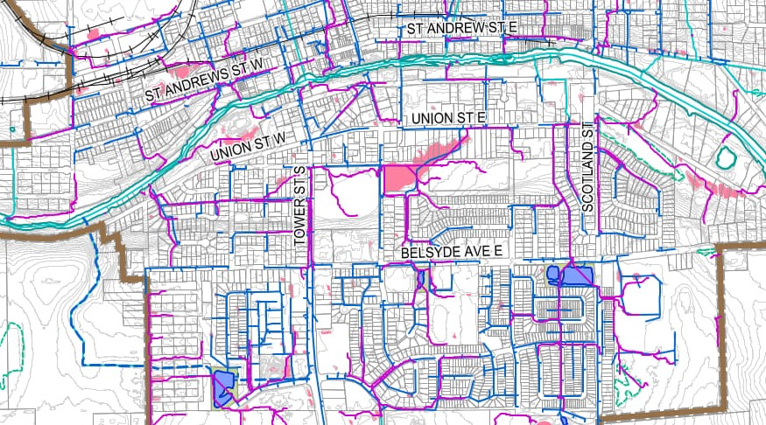
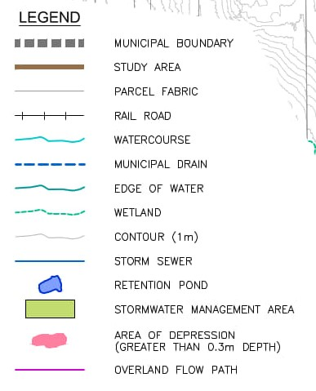
Brief Summary of Findings – Data Analysis
High-resolution topographic mapping data (LiDAR) was analyzed to understand if there are any issues with potential overland drainage, including:
Depression storage areas (areas without an overland outlet)
Areas with larger accumulations of overland flow
Overall, the results indicate most areas are well graded and sloped towards watercourses.
Some overland flow pathways through private property, which may require further review.

Slide 5
Next Steps
Schedule
The Study Team will
Review the comments received and incorporate key feedback into the study
Assess the effectiveness of existing stormwater drainage systems
Identify and evaluate alternative solutions for these areas to improve levels of service
Identify a recommended stormwater management strategy for the Township
February 2024
Evaluation of Alternatives and Development of a Preferred SWM Strategy
March 2024
PIC #2 to present the Preferred Solution
July 2024
Study Completion
Your Feedback is Invited!
Tell us about any known drainage and flooding related concerns / issues in your community. We encourage you to complete the comment form available at this Open House. The comment form can be submitted during this event. Comments can also be submitted via project webpage: https://www.connectcw.ca/swm-master-plan by November 2, 2023.
Project Contacts
Ryan Maiden, P.Eng (RMaiden@centrewellington.ca) | Matt Senior, P. Eng. (matt.senior@wsp.com)

